Slide 1
Bill of Materials: Prioritron Ver 2.0
Type: Ceramic Capacitor Ref: 100nF Qty: 5 Val: 100nF (104) | Type: Ceramic Capacitor Ref: 10nF Qty: 1 Val: 10nF (103) | Type: Electrolytic Capacitor Ref: 100uF Qty: 1 Val: 100uF
Type: Ceramic Capacitor Ref: 4.7nF Qty: 1 Val: 4.7nF (472) | Type: Monolithic Capacitor Ref: 10uF Qty: 2 Val: 10uF (106) | Type: jack Ref: Clock_IN, Clock_OUT, Audio Out Qty: 3 Val: Jack Socket "Headphone" socket
Type: JST Ref: JST 2P JST PH 2.0 Female Qty: 1 Val: JST 2P JST PH 2.0 Female | Type: Resistor Ref: 100K Qty: 1 Val: 100K | Type: Resistor Ref: 10K Qty: 6 Val: 10K
Type: Resistor Ref: 330R Qty: 2 Val: 330R | Type: Resistor Ref: 2K Qty: 5 Val: 2K | Type: RK097 Ref: 50K Pot Qty: 2 Val: 50K
Type: RK097 Ref: 10K Pot Qty: 1 Val: 10K | Type: tactile Ref: 12x12 Tactile Switch Qty: 1 Val: 12x12 Tactile Switch | Type: RK097 Ref: RotaryEncoder_Switch Qty: 1 Val:
104
103
100uF
472
106
50K
10K

Slide 2
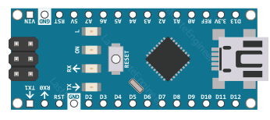
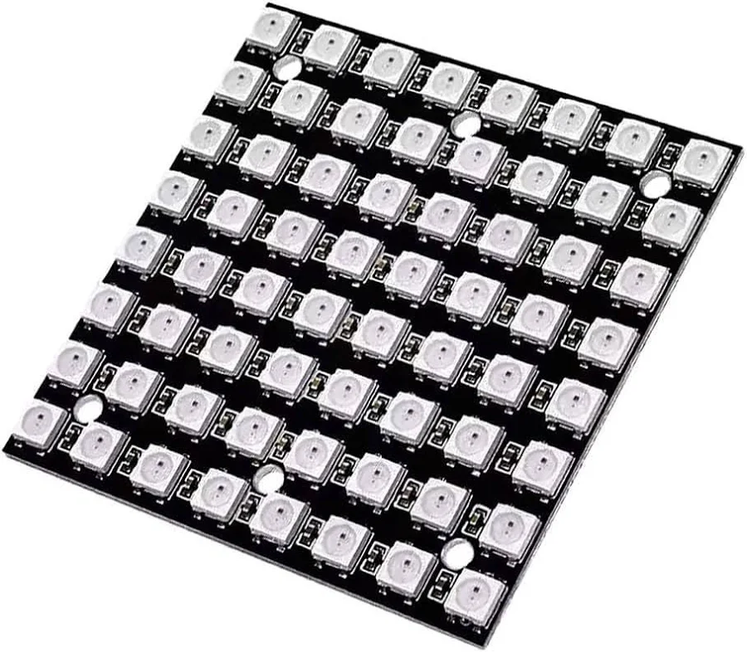
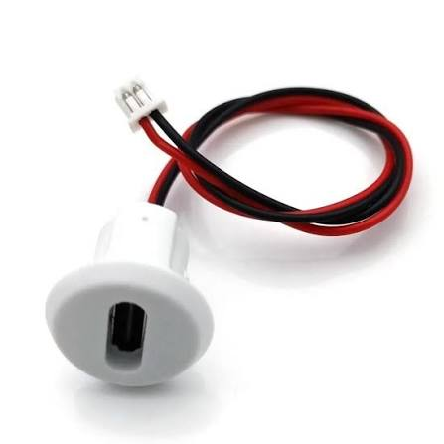
Bill of Materials: Prioritron Ver 2.0
Type: 8Pin Ref: OP AMP Qty: 1 Val: MCP6002 Check you get it the right way round - line up the semi circle. | Type: Arduino Nano Ref: Qty: 1 Val: | Type: 8x8 LED Matrix Ref: Qty: 1 Val: Solder the wires, onto the board and put three pieces of foam underneath to hold it against the screen.
Type: USB socket Ref: JST PH2.0 connector Qty: 1 Val: Test the circuit using the USB on the Arduino. If it works, collect one of these, pop it into the front panel and plug it in.
MCP6002

Slide 3
Additional Components
Reference | Value | Number | Notes

Slide 4
Full BOM
Reference | Number | Value | Type | Notes
100nF | 5 | 100nF (104) | Ceramic Capacitor
10nF | 1 | 10nF (103) | Ceramic Capacitor
100uF | 1 | 100uF | Electrolytic Capacitor
4.7nF | 1 | 4.7nF (472) | Ceramic Capacitor
10uF | 2 | 10uF (106) | Monolithic Capacitor
Clock_IN, Clock_OUT, Audio Out | 3 | Jack Socket | jack
JST 2P JST PH 2.0 Female | 1 | JST 2P JST PH 2.0 Female | JST
100K | 1 | 100K | Resistor
10K | 6 | 10K | Resistor
330R | 2 | 330R | Resistor
2K | 5 | 2K | Resistor
50K Pot | 2 | 50K | RK097
10K Pot | 1 | 10K | RK097
12x12 Tactile Switch | 1 | 12x12 Tactile Switch | tactile
RotaryEncoder_Switch | 1 |  | RK097
OP AMP | 1 | MCP6002 | 8Pin
15x1 Female Header | 2 |  | 15 Pin | For Arduino
8 Pin Dip Socket | 1
Arduino Nano |  |  | Most common variant with ATMega 328 | Arduino Nano with AtMega 168 will not work
USB Socket with JST Ph2.0

